Slide 1
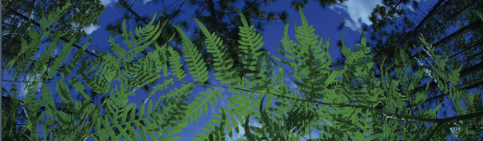



Post-ENM Analysis
Elizabeth White University of Florida

Slide 2
Post-ENM
Analysis in environmental space
Overview of commonly used post-modeling analyses.
Niche Breadth
Niche Overlap
Geographic Overlap
Niche Identity and Background test
Age overlap correlation test
Projecting models onto different climate scenarios (future)

Slide 3
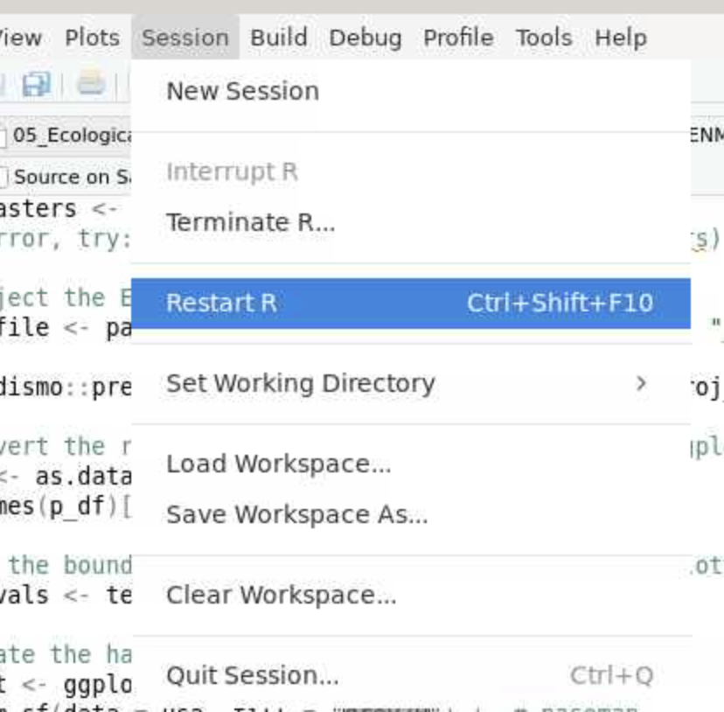

Slide 4
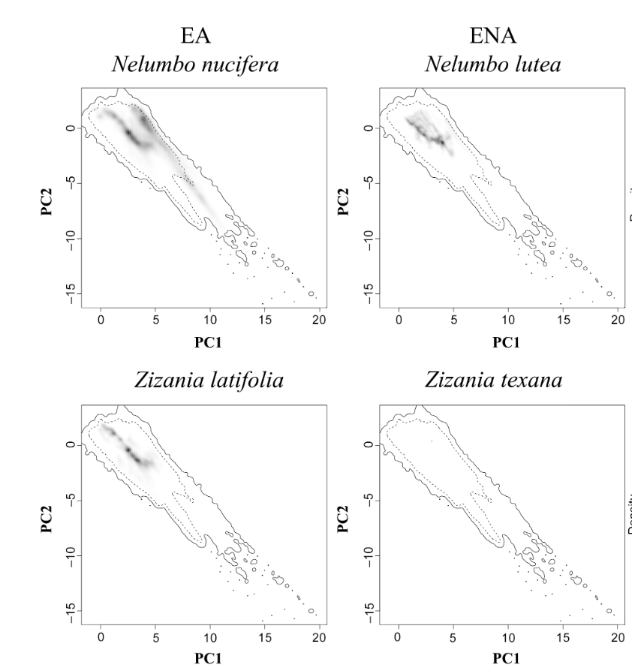
Analysis in environmental space
niche area = 27.3
Quantifying niches in environmental space
Niche area is equal to the variance of ecological space along PC1 × variance of ecological space along PC2
Larger niche area = more suitable area
niche area = 1.35× 10−5
Melton et al. 2022. Global Ecology and Biogeography.

Slide 5
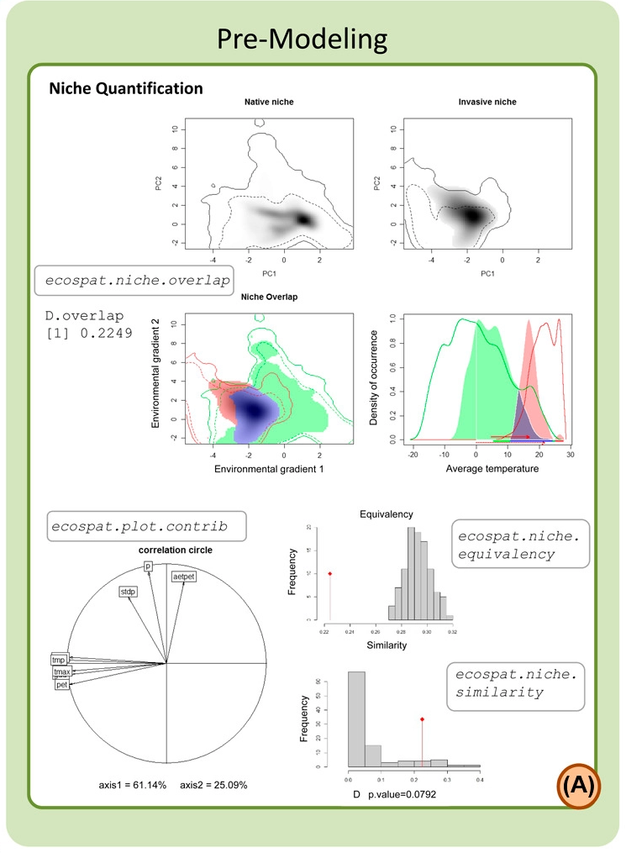
Post-ENM Analyses
Niche occupancy
Niche breadth
Niche overlap based on Schoener’s D
Correlation circle
Plots contribution of initial variables to variation seen in the data.
Niche Equivalency (Graham et al. 2004)
Are the niche of two species indistinguishable?
Niche Similarity (Peterson et al. 1999)
Can the niche of one species predict that of another?
Di Cola et al. 2017. Ecography.

Slide 6
Post-ENM Analyses
Niche occupancy
Niche breadth
Niche overlap based on Schoener’s D
Correlation circle
Plots contribution of initial variables to variation seen in the data.
Niche Equivalency (Graham et al. 2004)
Are the niche of two species indistinguishable?
Niche Similarity (Peterson et al. 1999)
Can the niche of one species predict that of another?
Di Cola et al. 2017. Ecography.

Slide 7
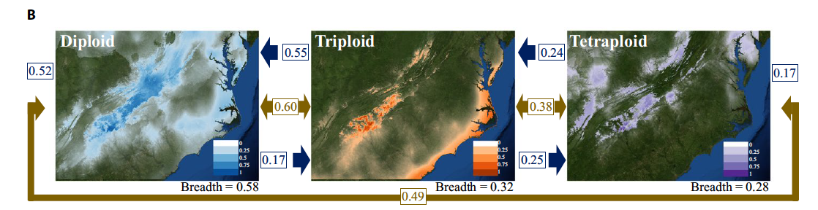
Post-ENM: Niche Breadth
Niche breadth:
is a means of calculating the breadth of suitable climatic factors for a species, providing a value ranging from 0 to 1.
larger values represent more generalist species with wider climatic tolerances
smaller values represent more specialized species with more narrow tolerance
Gaynor et al. 2018. American Journal of Botany.

Slide 8
Post-ENM: Niche Overlap
Niche overlap (gold):
Schoener’s D ranges from 0 to 1
0 represents no niche similarity between the models
1 represents completely identical niches
Gaynor et al. 2018
Gaynor et al. 2018. American Journal of Botany.

Slide 9
Post-ENM: Niche Overlap
Niche overlap (gold):
Schoener’s D ranges from 0 to 1
0 represents no niche similarity between the models
1 represents completely identical niches
Geographic Overlap (blue):
percentage of points found in the models A distribution relative to those in the model Bs distribution.
Gaynor et al. 2018
Gaynor et al. 2018. American Journal of Botany.

Slide 10
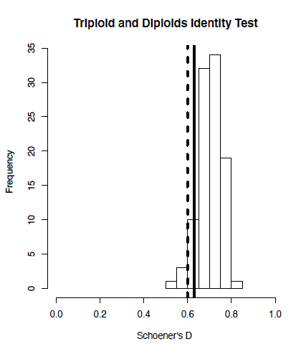
Niche Identity and Background Test
Niche Identity Test:
Niche Equivalency (Graham et al. 2004)
Are the niches of two species indistinguishable?
Compares niche models with the same number of occurrence records as the original models, but with randomly distributed localities x 100
Niche Background Test:
Niche Similarity (Peterson et al. 1999)
Keep one species fixed, randomly sample the background of the other
Are niche more similar than expected by chance?
Warren et al. 2010. ENMTools: a toolbox for comparative studies of environmental niche models

Slide 11
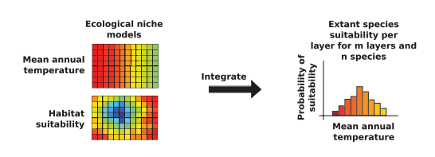
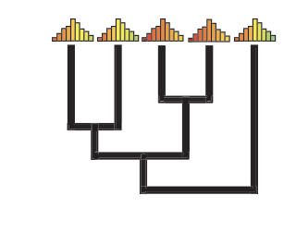
Niche and Phylogenetics
Point-Based
Principal Component Analysis (PCA)
Age-overlap correlation test:
Range & point based
Model-based
Phylogenetic PCA (pPCA)
Blomberg’s K statistic and Pagel’s lambda
Ecological Niche Shifts
R package l1ou
Predicted Niche Occupancy
Folk et al. 2018. The American Naturalist.

Slide 12
Niche and Phylogenetics
Point-Based
Principal Component Analysis (PCA)
Age-overlap correlation test:
Range &point based
Model-based
Phylogenetic PCA (pPCA)
Blomberg’s K statistic and Pagel’s lambda
Ecological Niche Shifts
R package l1ou
Predicted Niche Occupancy
Folk et al. 2018. The American Naturalist.

Slide 13
Age overlap correlation test
Range Overlap
Point Overlap
Local
co-occurrence
Allopatric
Allopatric
Sympatric
Sympatric
Cardillo and Warren. 2016. Global Ecology and Biogeography.

Slide 14
Age overlap correlation test
identical niches
1
Ecological Niche Overlap
Schoener’s D
no overlap
0
Age (MYA)

Slide 15
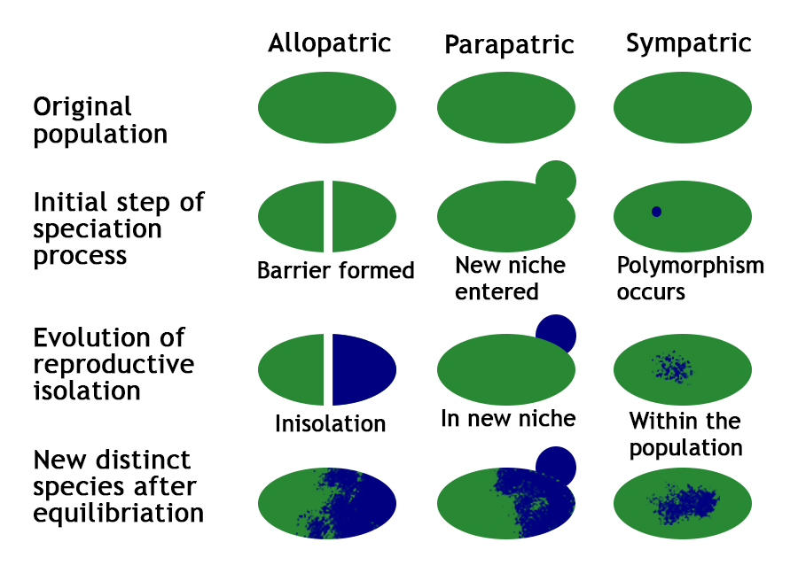
Age overlap correlation test
identical niches
1
Ecological Niche Overlap
Schoener’s D
no overlap
0
Age (MYA)
Mode of Speciation | Intercept | Slope
Sympatric | > 0.5
Allopatric | < 0.5 | positive
Parapatric | < 0.5 | near or below 0
Fitzpatrick & Turelli. 2006. Evolution.

Slide 16
Age overlap correlation test
Point-based
Galax urceolata
0.233
0.890
Pyxidanthera barbulata
Pyxidanthera brevifolia
Ecological overlap
0.068
0.213
Shortia sinensis
0.000
0.000
Shortia uniflora
0.000
0.000
0.000
0.000
Shortia rotundifolia
0.003
0.000
Shortia galacifolia
0.026
0.033
Schizocodon soldanelloides
Age (MYA)
0.216
0.670
Schizocodon ilicifolius
Range-based
0.002
0.009
Diapensia wardii
0.093
0.068
0.350
0.339
0.211
0.269
Diapensia obovata
0.006
0.017
Diapensia lapponica
Diapensia purpurea
Ecological overlap
0.377
0.394
Diapensia himalaica
Berneuxia thibetica
Gaynor et al. 2020. Journal of Systematics and Evolution.
Age (MYA)
Notes:
Both suggested lots of instances of Parapatric, which has been associated with phylogenetic niche divergence

Slide 17
Age overlap correlation test
Point-based
Galax urceolata
0.233
0.890
Pyxidanthera barbulata
Pyxidanthera brevifolia
Ecological overlap
0.068
0.213
Shortia sinensis
0.000
0.000
Shortia uniflora
0.000
0.000
0.000
0.000
Shortia rotundifolia
0.003
0.000
Shortia galacifolia
0.026
0.033
Schizocodon soldanelloides
Age (MYA)
0.216
0.670
Schizocodon ilicifolius
Range-based
0.002
0.009
Diapensia wardii
Mode of Speciation | Intercept | Slope
Sympatric | > 0.5
Allopatric | < 0.5 | positive
Parapatric | < 0.5 | near or below 0
0.093
0.068
0.350
0.339
0.211
0.269
Diapensia obovata
0.006
0.017
Diapensia lapponica
Diapensia purpurea
Ecological overlap
0.377
0.394
Diapensia himalaica
Berneuxia thibetica
Gaynor et al. 2020. Journal of Systematics and Evolution.
Age (MYA)
Notes:
Both suggested lots of instances of Parapatric, which has been associated with phylogenetic niche divergence

Slide 18
Age overlap correlation test
Point-based
Galax urceolata
0.233
0.890
Pyxidanthera barbulata
Allopatric
Pyxidanthera brevifolia
0.068
0.213
Ecological overlap
Shortia sinensis
0.000
0.000
Shortia uniflora
0.000
0.000
0.000
0.000
Shortia rotundifolia
0.003
0.000
Shortia galacifolia
0.026
0.033
Age (MYA)
0.216
0.670
Schizocodon soldanelloides
Allopatric
Range-based
Schizocodon ilicifolius
0.002
0.009
Diapensia wardii
0.093
0.068
0.350
0.339
0.211
0.269
Diapensia obovata
Parapatric
Diapensia lapponica
Ecological overlap
0.006
0.017
0.377
0.394
Diapensia purpurea
Parapatric
Diapensia himalaica
Berneuxia thibetica
Gaynor et al. 2020. Journal of Systematics and Evolution.
Age (MYA)

Slide 19
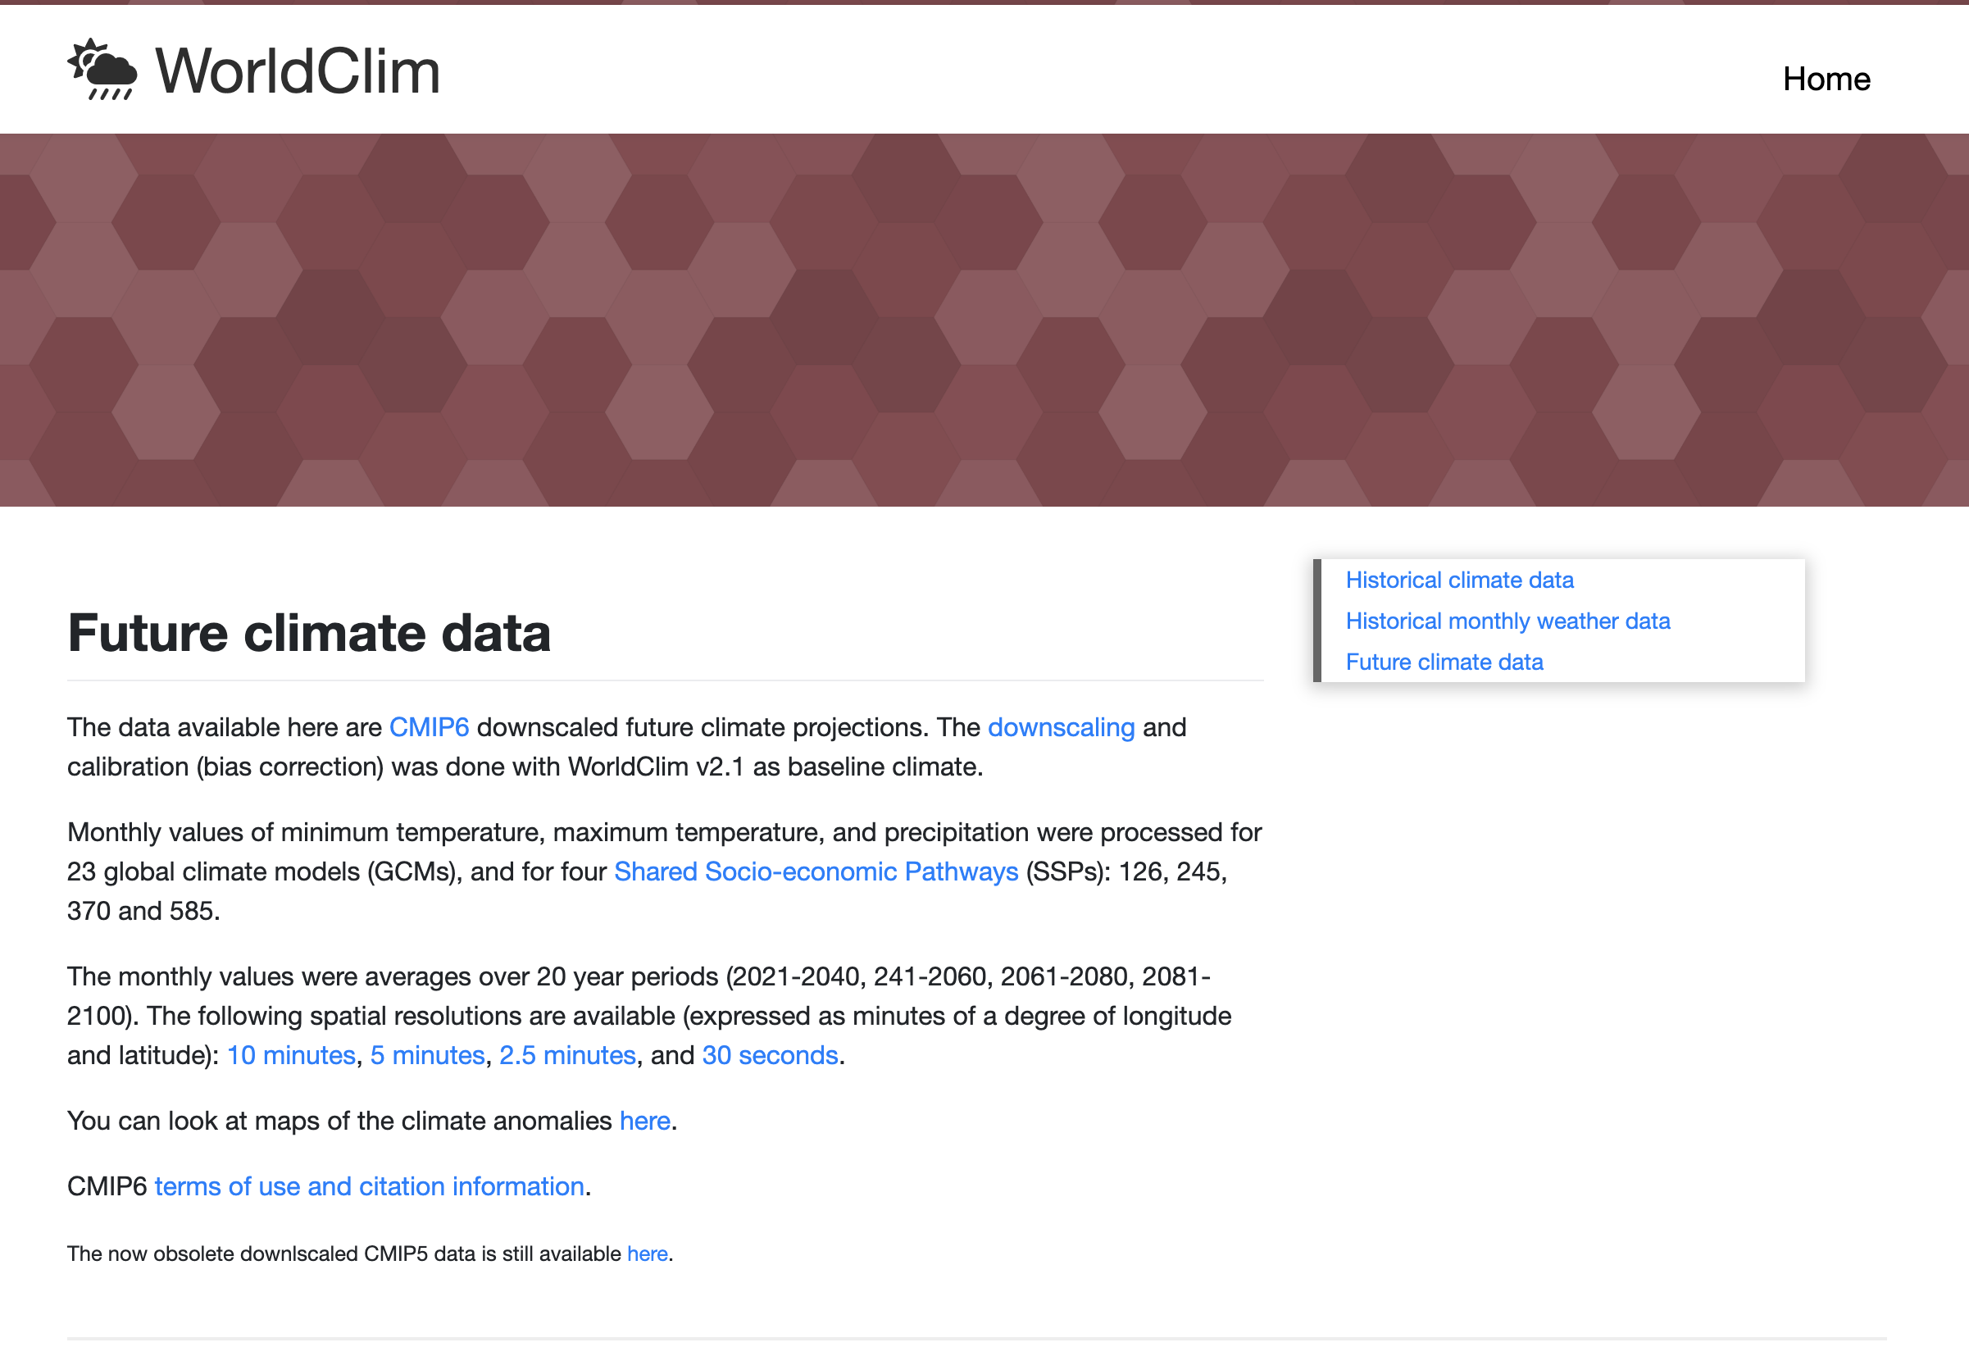
Projecting models to future climates
Predict potential range shifts under different climate change scenarios
Assess vulnerability of rare or endemic species
Inform conservation planning
GCM data available at: https://www.worldclim.org/data/cmip6/cmip6climate.html

Slide 20
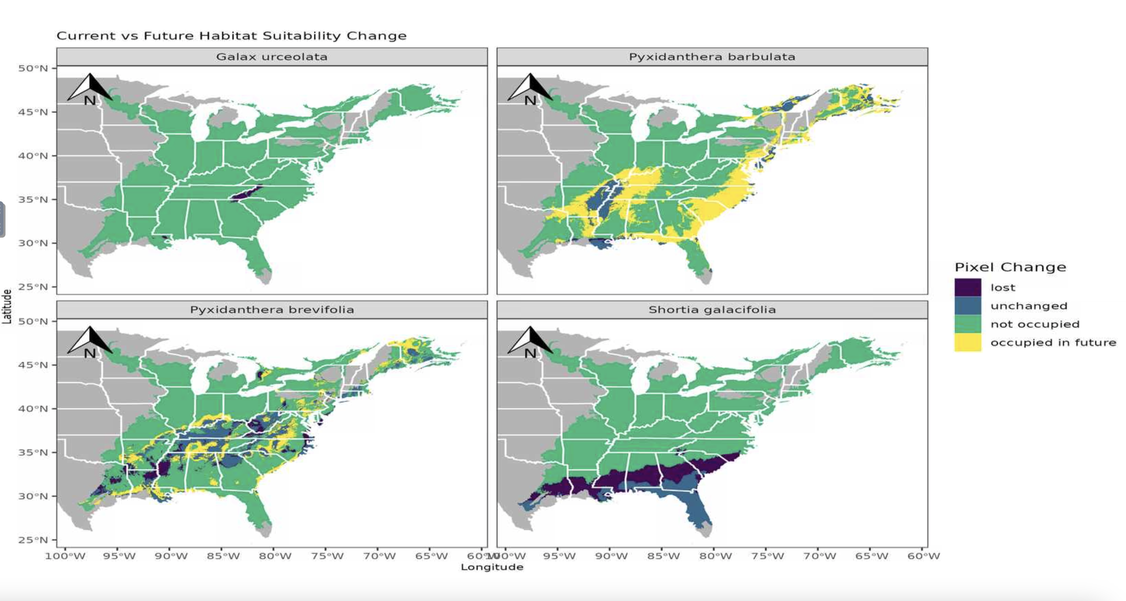
Projecting models to future climates

Slide 21
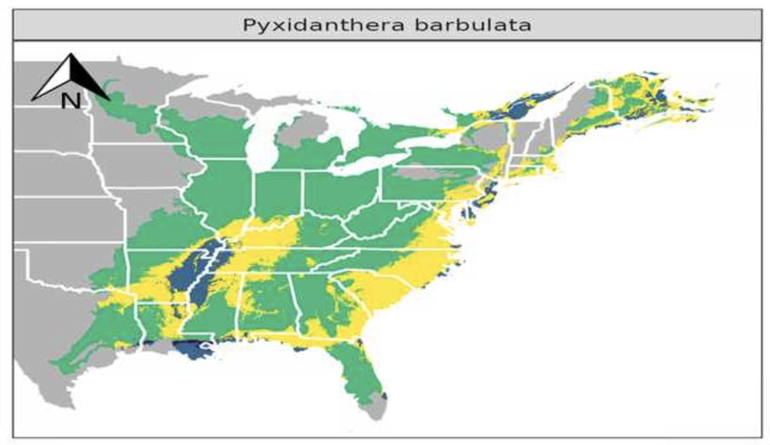
Projecting models to future climates
Caveats to accessible areas- avoid overinterpretation of models based on what you know about the region
Uncertainty from model choice, resolution, and GCMs

Slide 24
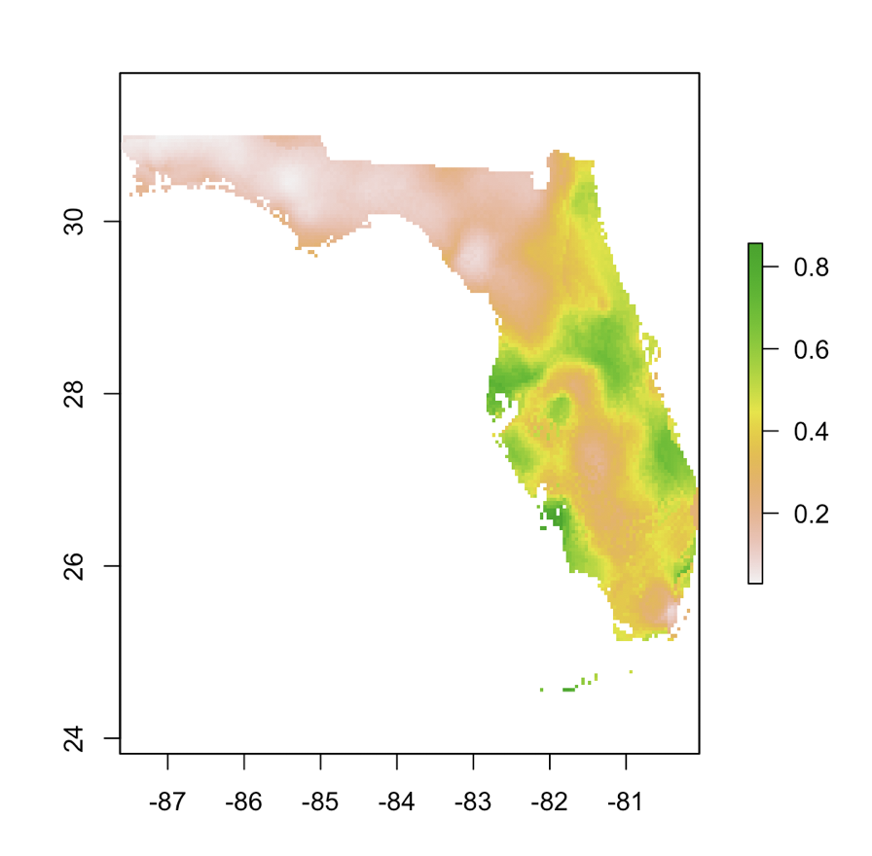
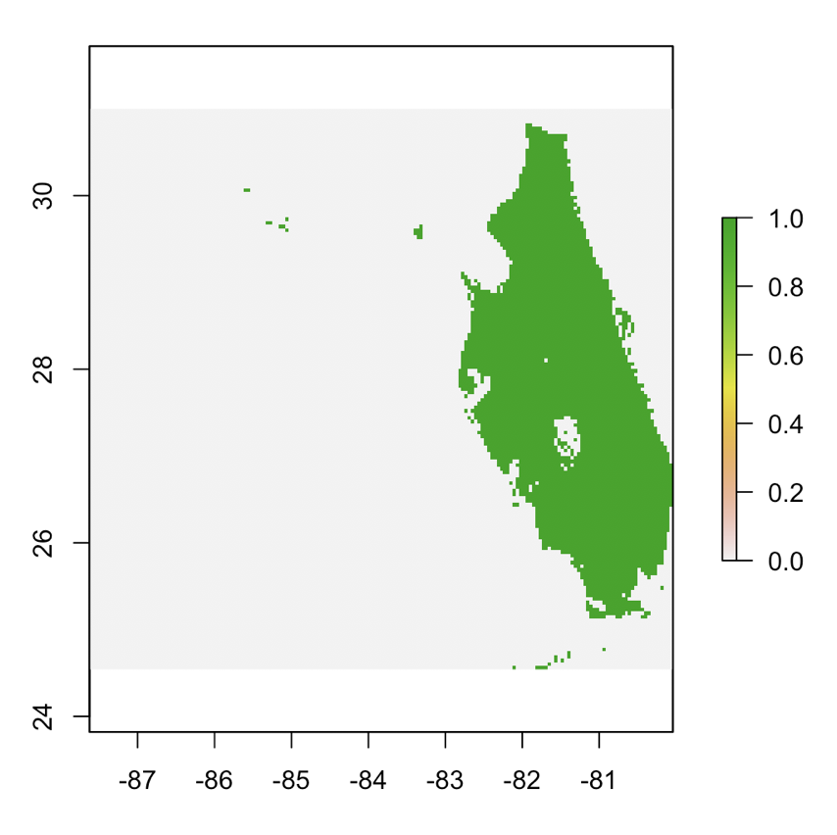
Post-ENM
Geographic Overlap
Reclassify

Slide 25

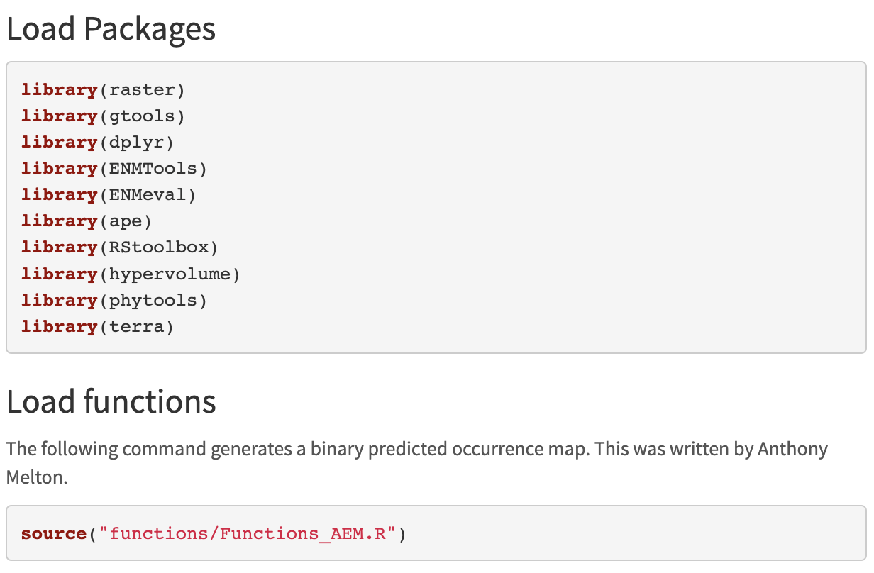
Load Packages and Functions
Dr. Anthony Melton

Slide 26
Projecting models to future climates
Different climate change scenarios/models GCM, RCP, SSM tables of scenarios
Our resolution is late century (2081-2100)

Slide 27
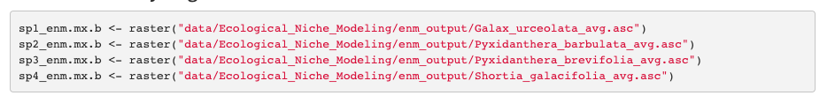
Load ENM Models

Slide 28
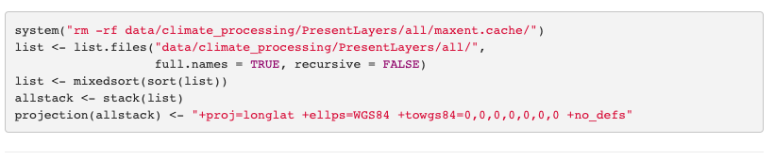
Load Bioclim layers

Slide 29
ENM Breadth
Niche breadth is the breadth of environmental factors for a species’ niche, ranging from 0 to 1.
When breadth is closer to 1 the more generalist species with wider tolerances.
Values closer to 0 indicate a more specialized species.
The raster.breadth command in ENMTools measures the smoothness of suitability scores across a projected landscape. The higher the score, the more of the available niche space a species occupies.

Slide 30
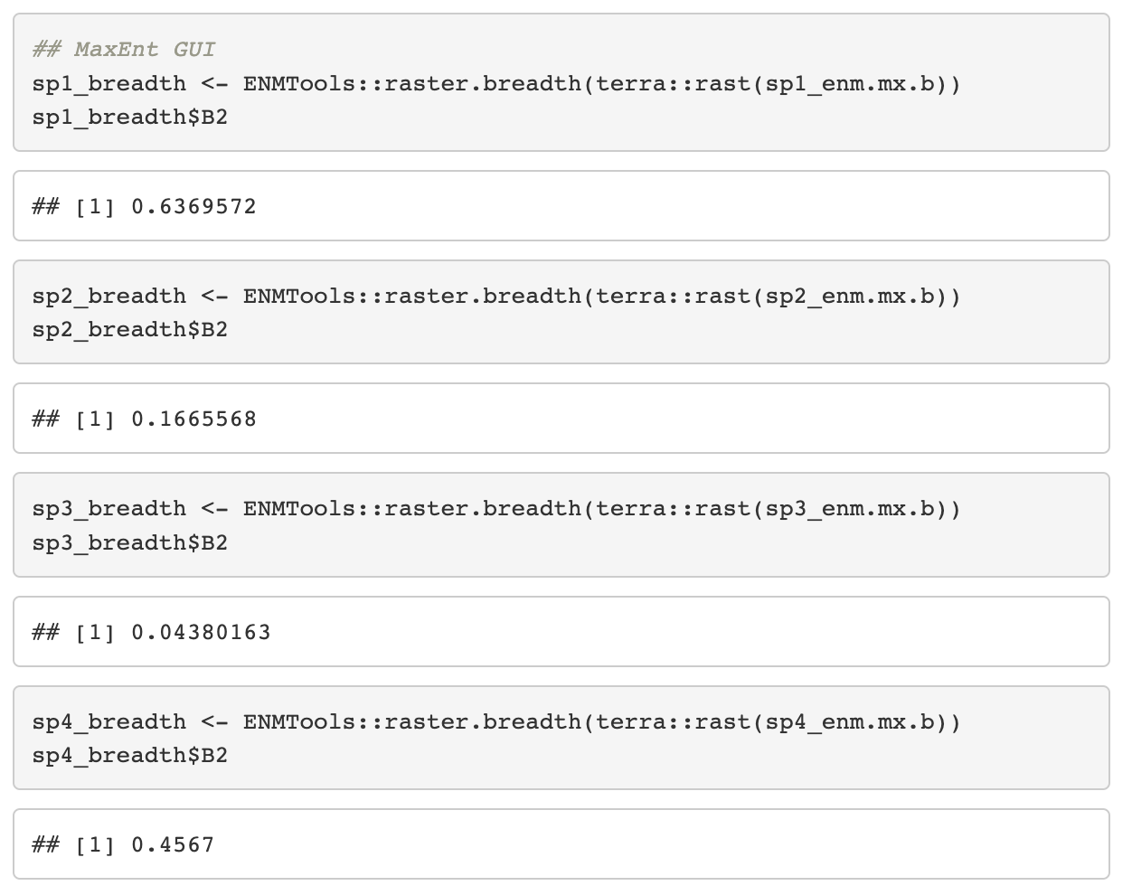
ENM Breadth

Slide 31
ENM Overlap
Calculating niche overlap:
Schoener’s D, with ENMEval - Schoener’s D ranges from 0 to 1
0 represents no similarity between the projections
1 represents completely identical projections.

Slide 32
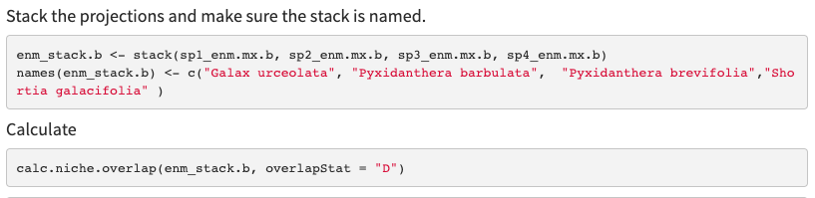
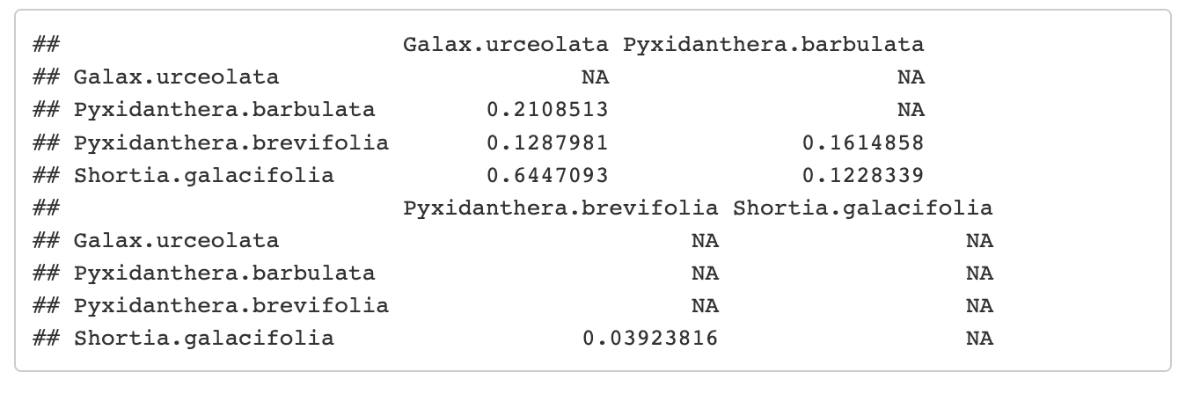
ENM Overlap

Slide 33
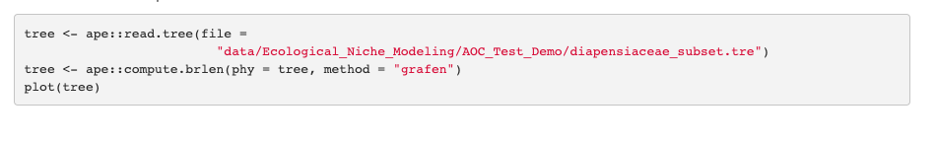
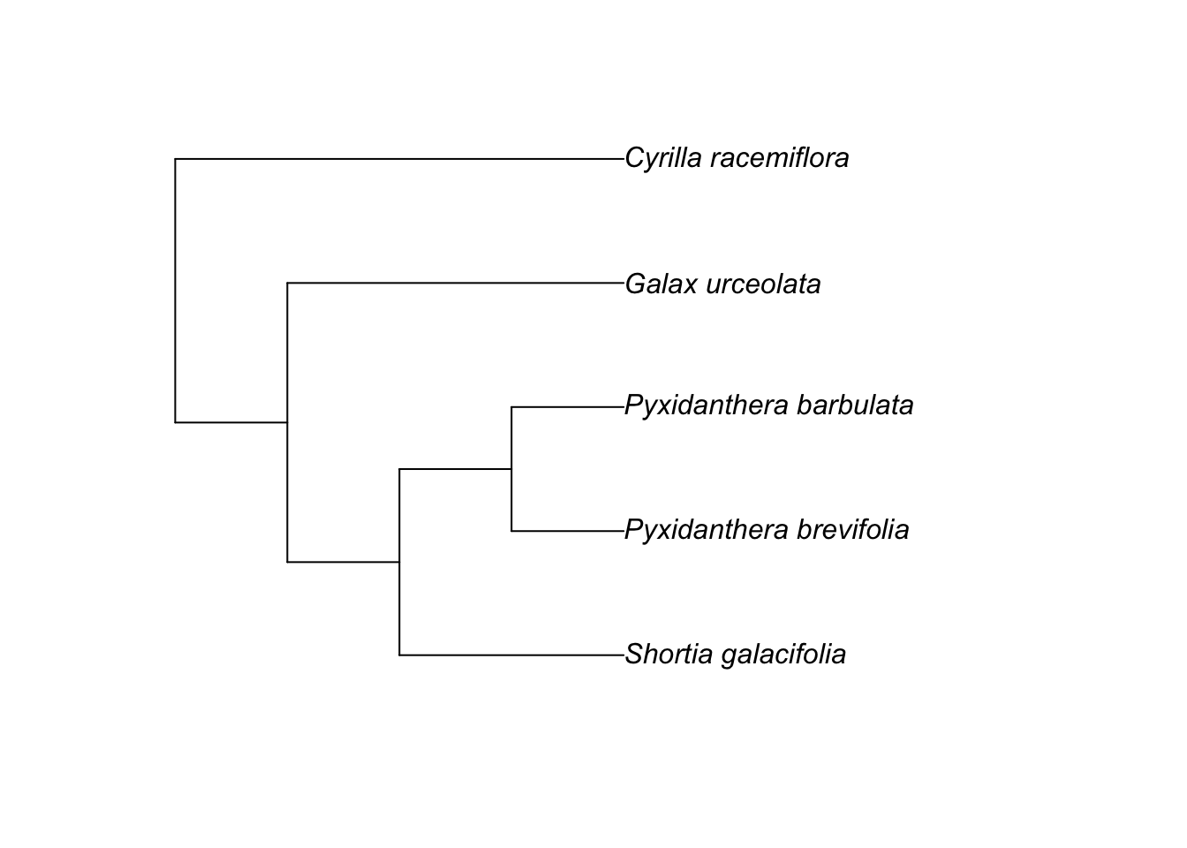
Phylogenetic correlation

Slide 34

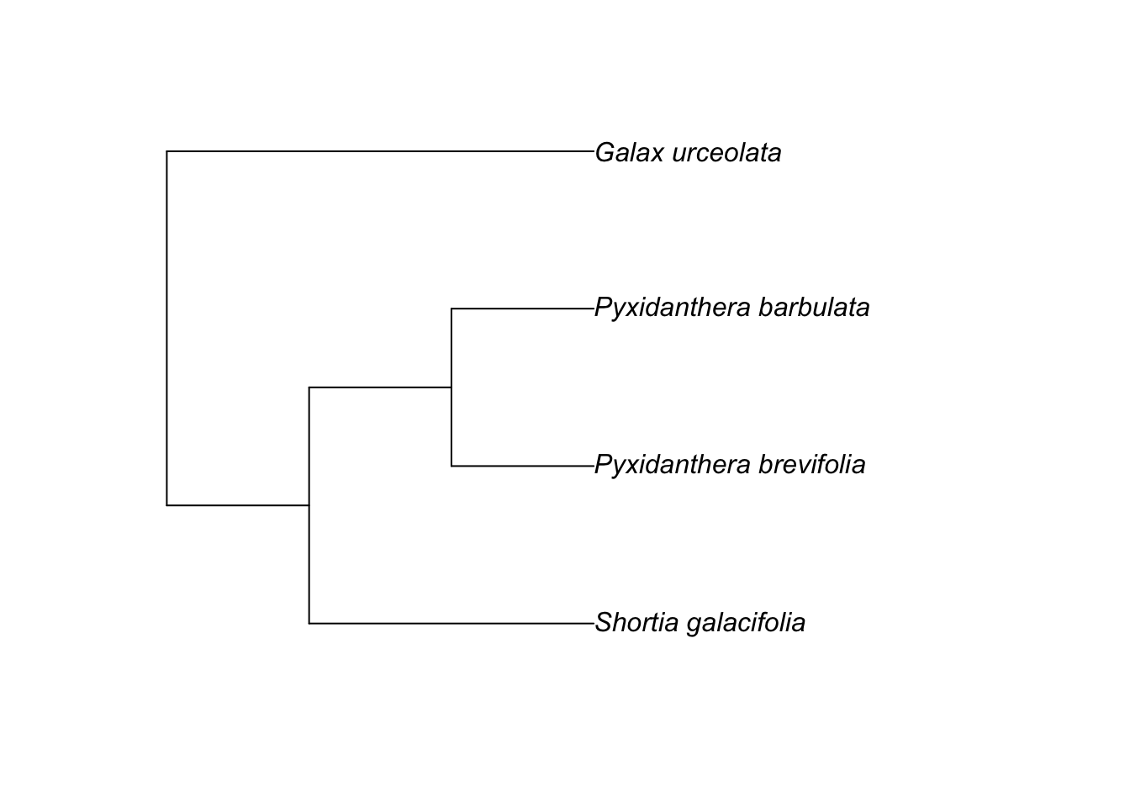
Phylogenetic correlation

Slide 35
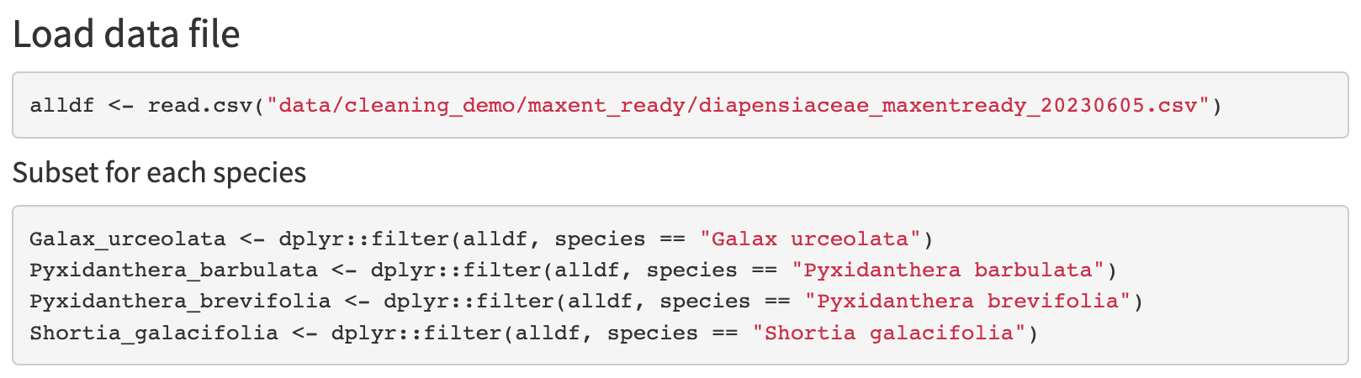
Phylogenetic correlation

Slide 36
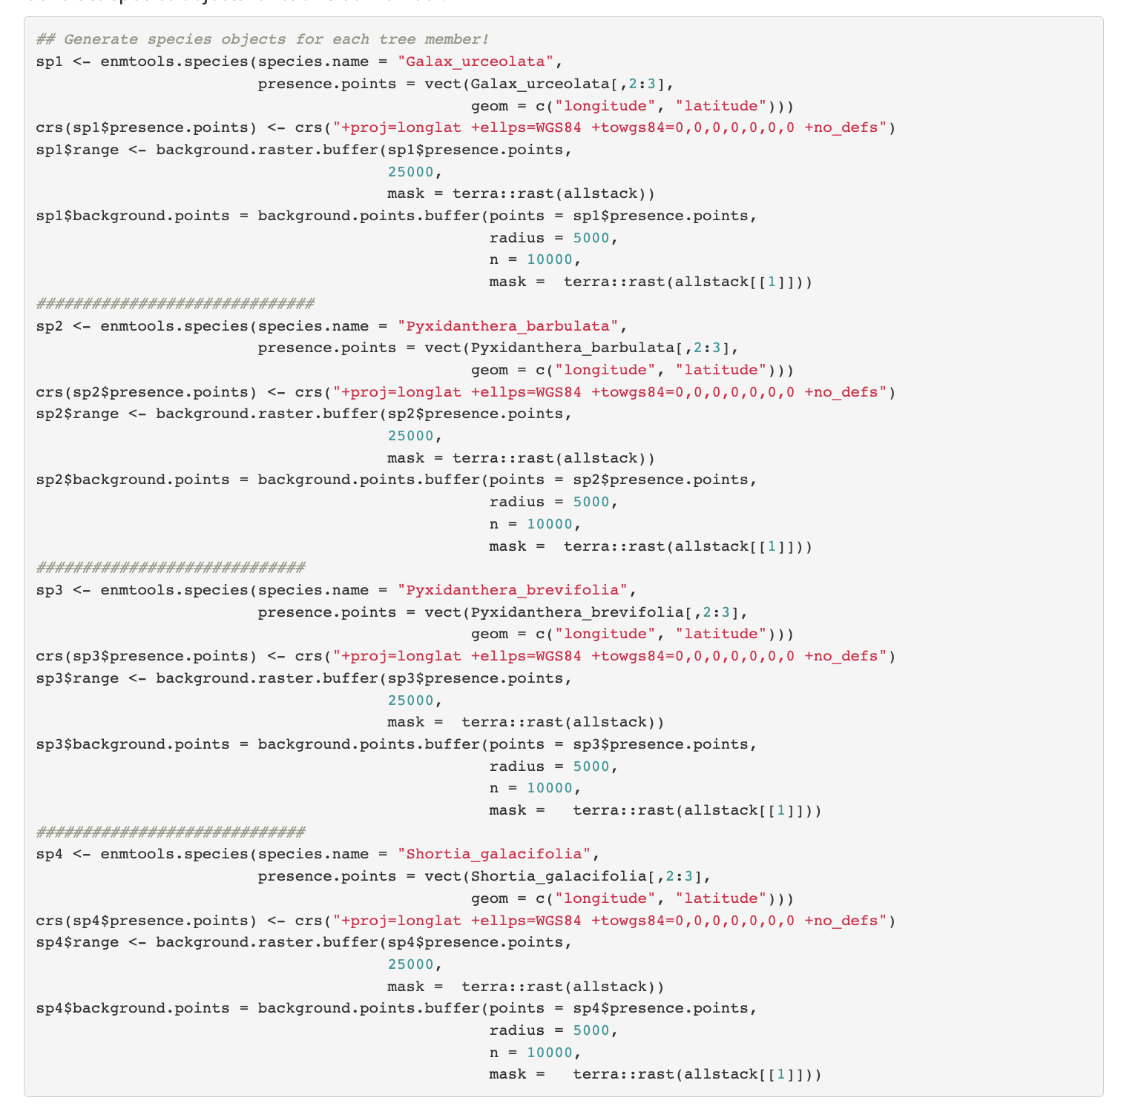
Phylogenetic correlation

Slide 37
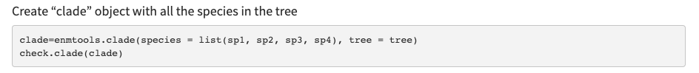
Phylogenetic correlation

Slide 38
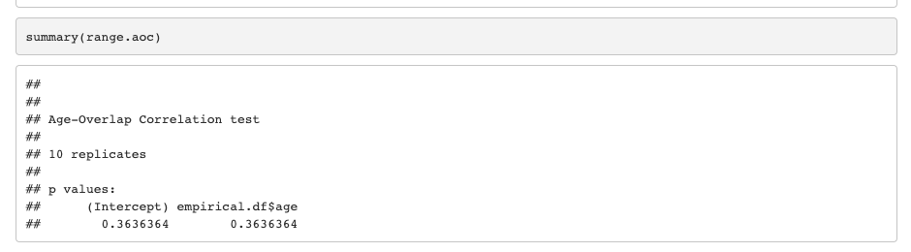
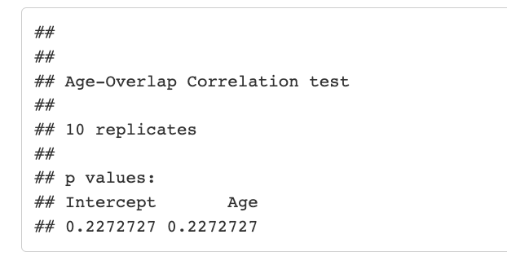
Phylogenetic correlation

Slide 39
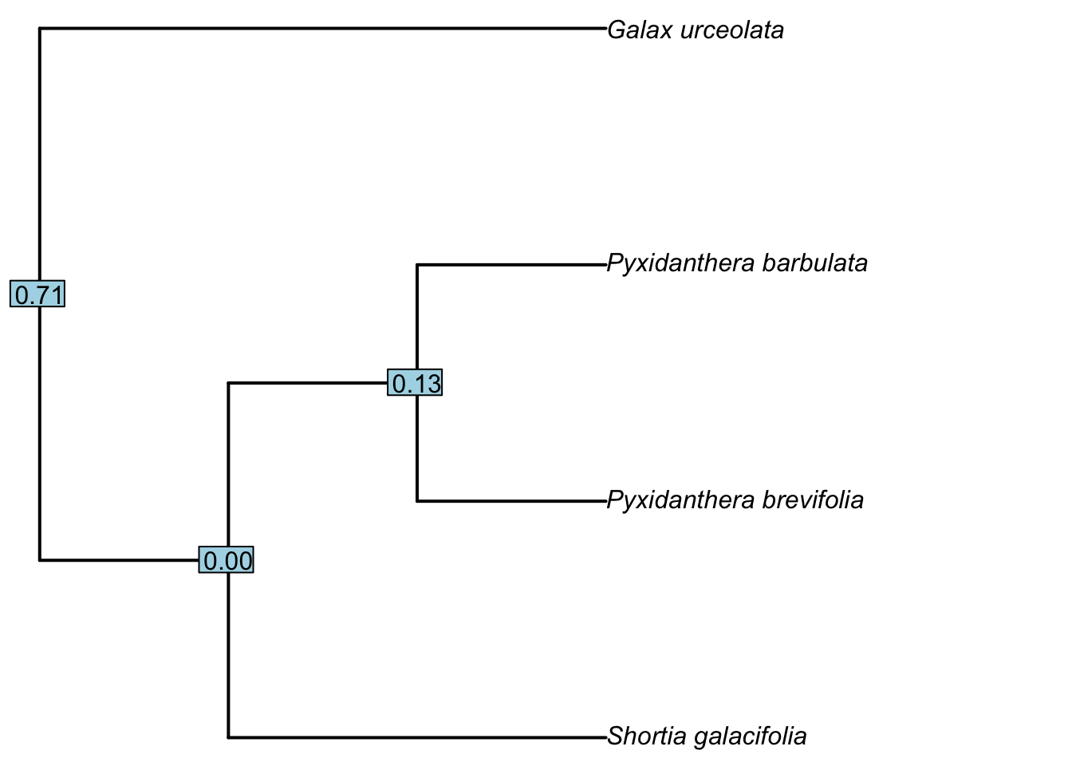
Phylogenetic correlation

Slide 40
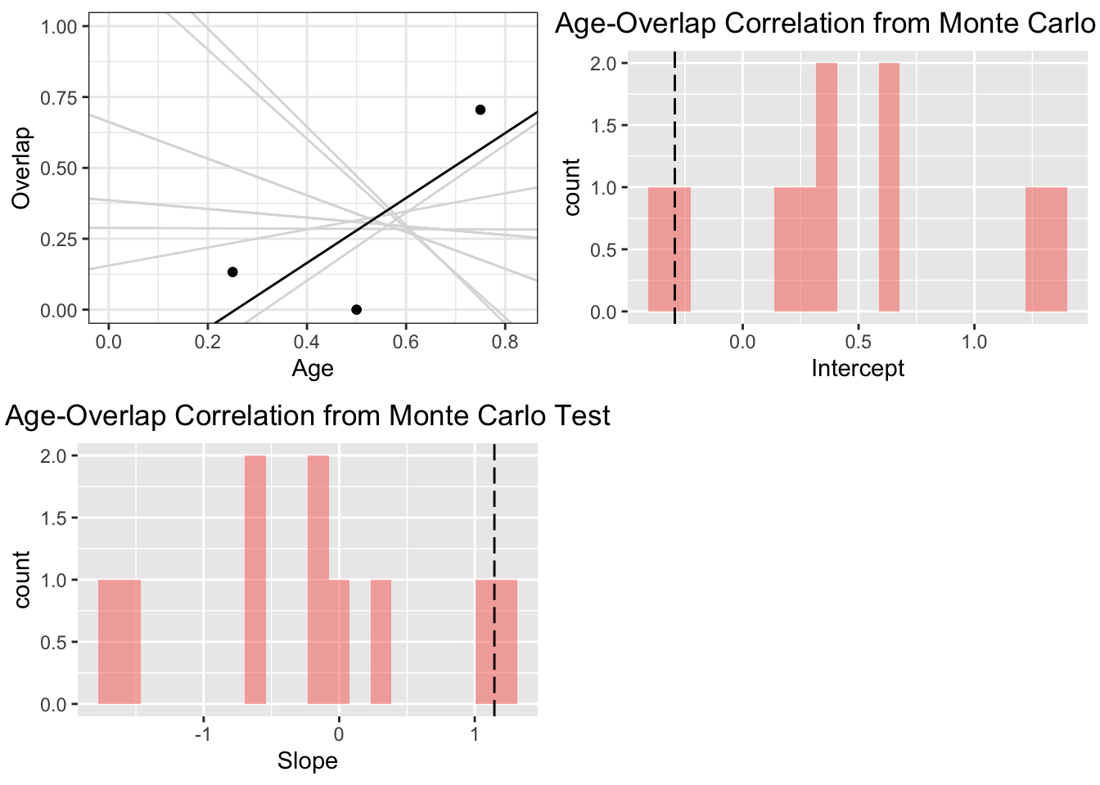
Phylogenetic correlation

Slide 41
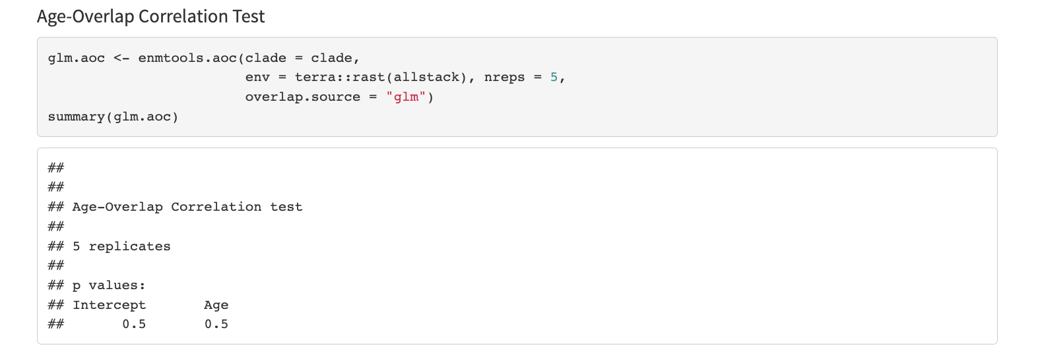
Phylogenetic correlation

Slide 42
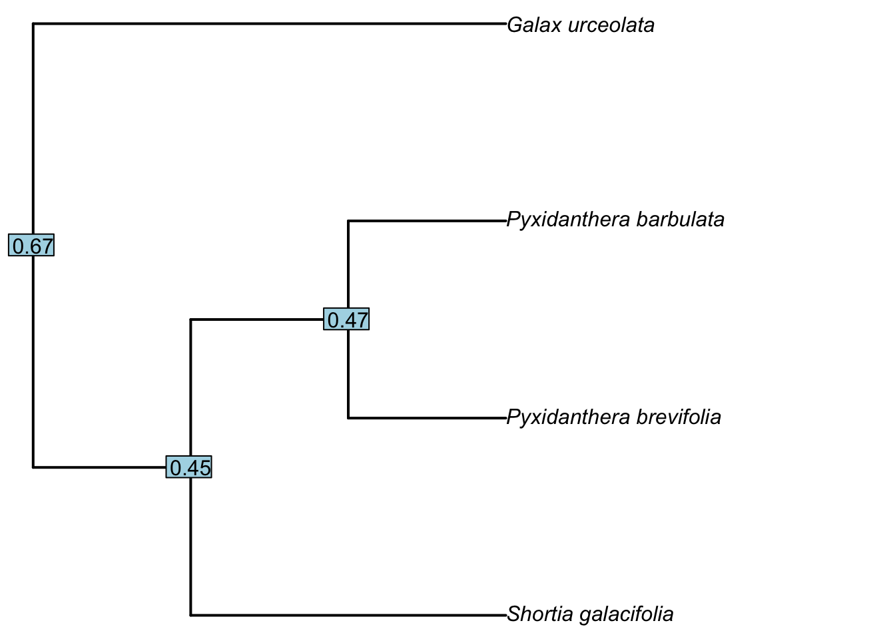
Phylogenetic correlation

Slide 43
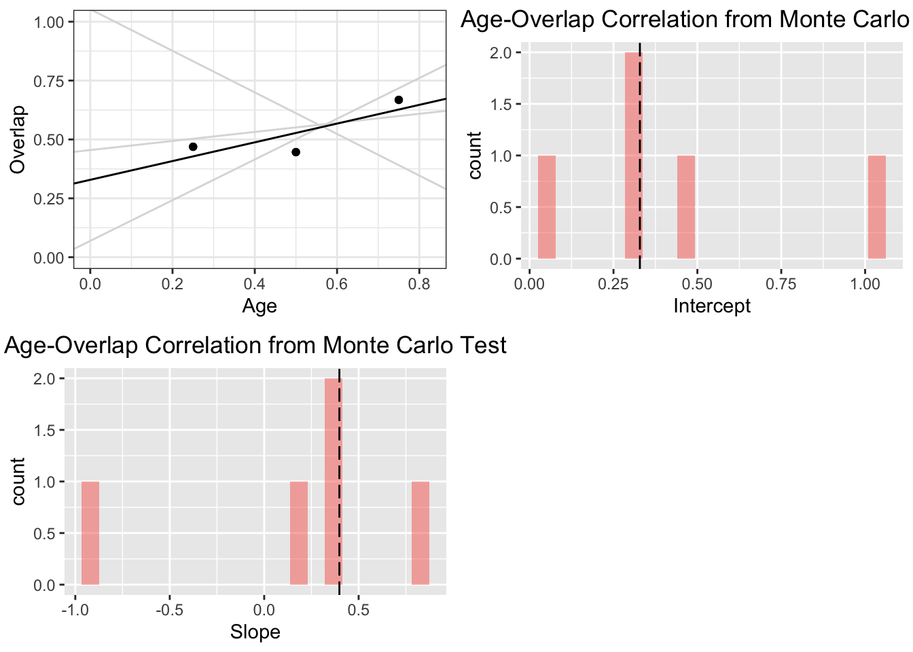
Phylogenetic correlation

Slide 44
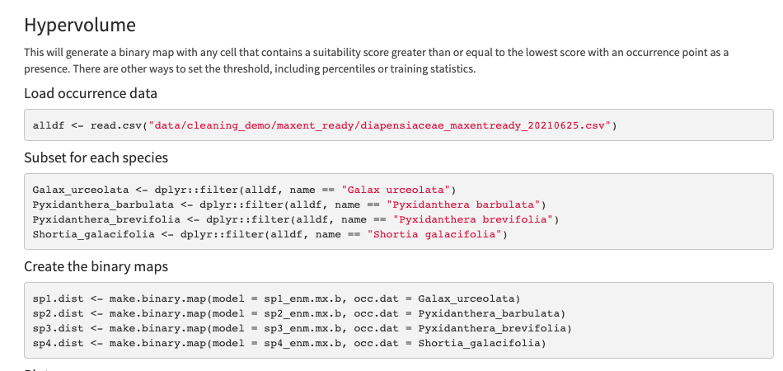
Hypervolume
Dr. Anthony Melton

Slide 45
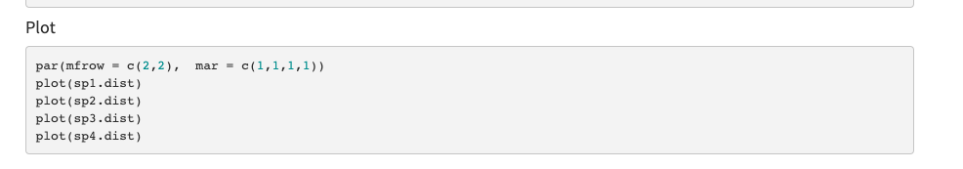
Hypervolume
Dr. Anthony Melton

Slide 46
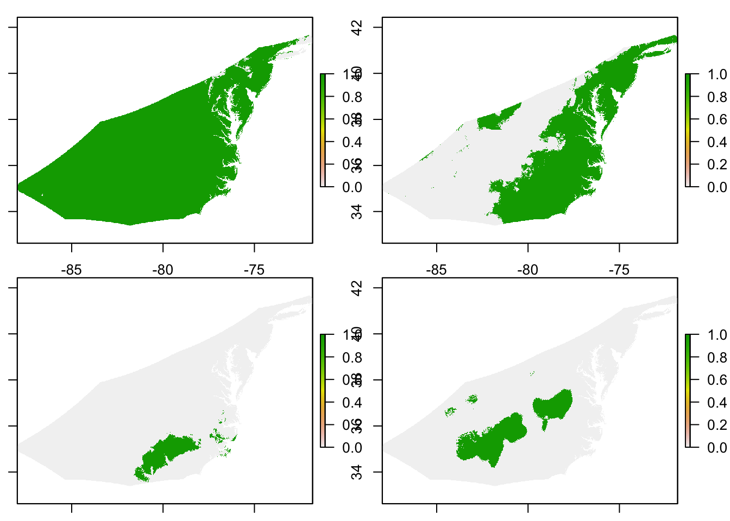
Dr. Anthony Melton

Slide 47
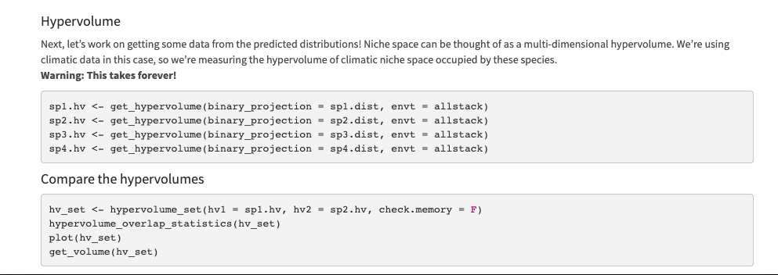
Hypervolume
Dr. Anthony Melton

